Slide 1
CS 540 Network Architecture
Lecture 14: TCP for Data Center Networks
Prof. Younghee Lee

Slide 2
Appropriate TCP for an application
TCP problem
Just guess what happens in the network or the other end node without any explicit indication from the networks.
Congestion? Errors? Receiver’s buffer overflow?
But you can modify TCP for your applications
You need to understand how TCP works.
You may either modify TCP or choose appropriate TCP version for your application.
Possible approaches
Modification of congestion window control mechanism, RTT/RTO, ..
Congestion control without using packet loss indication
Proactive control instead of reactive control such as packet loss
Sending rate control instead of cwnd control
Use of Explicit Congestion/error indication
…..

Slide 3
TCP for Data Center Networks
Transport inside the DC: TCP <= 99.9% of traffic
Partition/Aggregate(query) : delay sensitive
Incast : n to 1 synchronized mice collide
Need high burst tolerance
Short messages(coordination, control) : delay sensitive
Big flows buildup queues: increased latency for short flows
Need low latency, shallow buffer : AQM –RED?
Large flows(Data update) : Throughput sensitive
Buffer pressure
Need high throughput, deep buffer(contradiction): Reduced RTO_{min}?

Slide 4
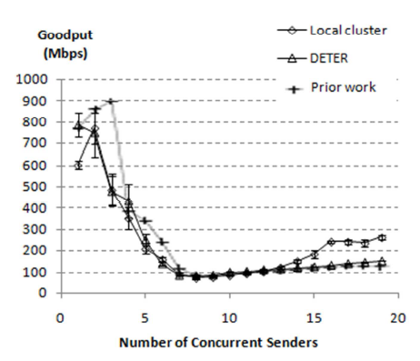
Incast
Incast problem: On Line Data Intensive applications(OLDI)
Parallel cluster file systems
Massive multi-server queries
Web search
MapReduce: Reduce() procedure
Small RPC-request/response with tight deadlines
TCP Timeout
Bottleneck
client
switch
servers
Jacobson’s TCP RTO Estimator
RTO = SRTT + 4*SDEV
Minimum RTO bound = 200ms
Actual RTO Timer = max(200ms, RTO)

Slide 5
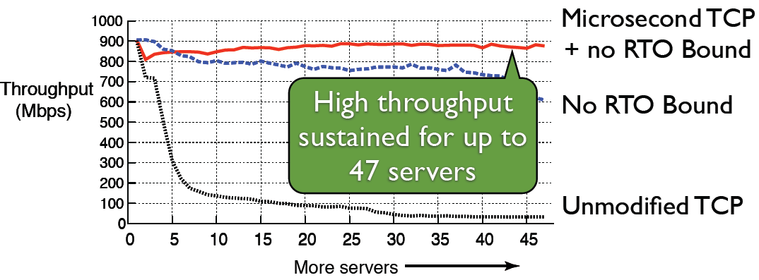
Incast – fine grained RTO
Vasudevan et al. “Safe and effective Fine-grained TCP Retransmissions for Datacenter Communication”, SIGCOMM 2009
Reduce TCP RTO_{min} (Unmodified TCP: 200ms): or no RTO Bound
1 line change in Linux: but1ms timer => not enough
Use high resolution timers
Track RTT in microseconds for RTO
Efficient high resolution kernel timers
HPET for interrupt signaling
HPET: High Precision Event Timer: hardware timer

Slide 6
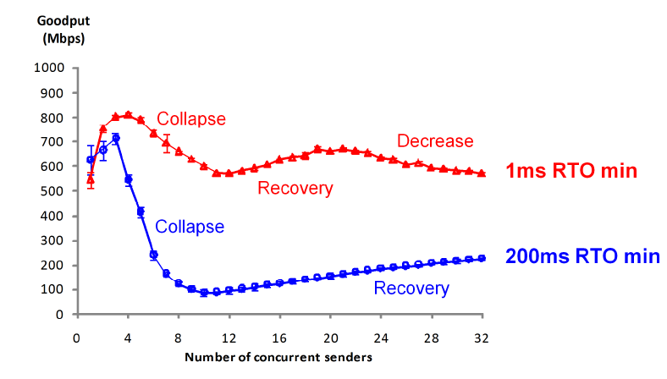
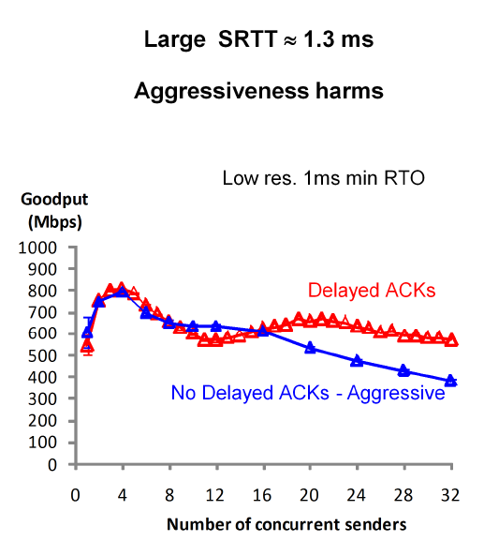
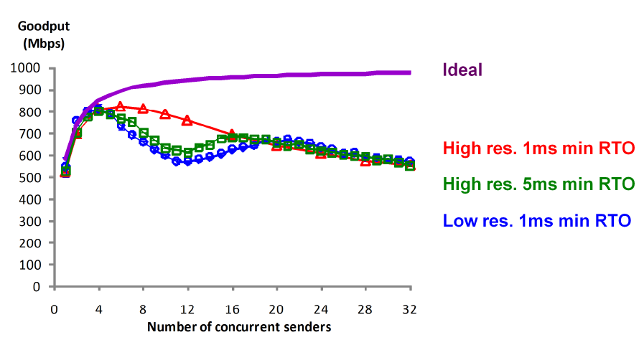
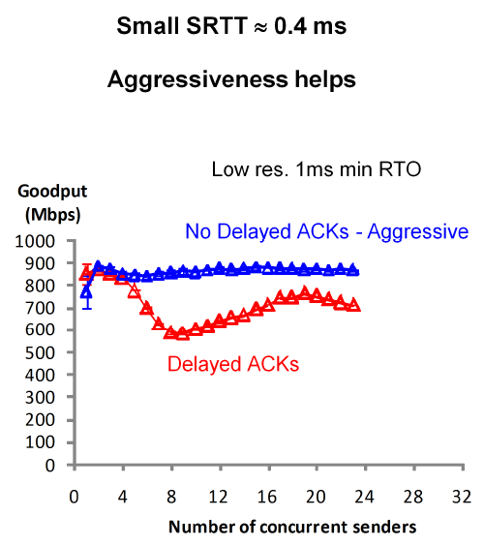
Incast – fine grained RTO
Different H/W
Different H/W
Adaptive cwd management?
Still need to improve

Slide 7
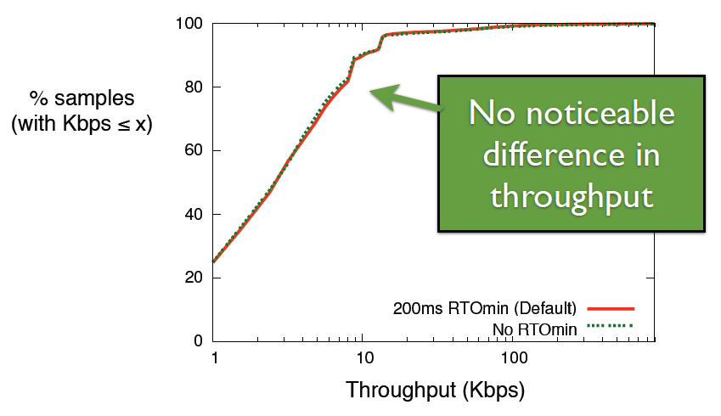
Wide area performance without RTO_{min}
No RTObound (RTO_{min}) is safe for wide area communications

Slide 8
Tail latency
Causes
Device failure, Uneven-split of data btw tasks
Network congestion for reducers
Approach: Spread out reducers?: not sufficient
RTT?
Average RTT: few hundreds of micro sec
But 5~6% of them : multi msec
Longest: 10 ~ 20ms
From Server through multiple intermediate switches => multi hundreds of msec.
sometimes more than 300 mses => affects OLDI service quality
Approaches
Make the network faster: HULL, DeTail, DCTCP
Fat-Tree... + increase throughput: not latency
but usually smaller tail with faster network
Eliminate bursts and buffering: Hull(introduce longer latency)
Optimize how application use the network: Orchestra, CoFlow
Make the network aware of Dealine: D3, PDQ, D²TCP
Earlist deadline first: PDQ
BW reservation for each flow: need extreamly fast control
Vary sending rate based on both deadline and extent of congestion: D²TCP

Slide 9
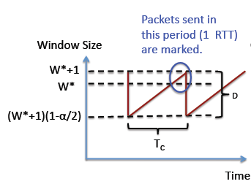



Data Center TCP (DCTCP) SIGCOMM 2010
Explicit Congestion Notification
Switch: mark packets when queue length exceed threshold k
F: the fraction of packets that were marked in the last window of data
Adaptive window decrease
Mark based on instantaneous queue length for faster feedback to better deal with bursts
ECN mechanisms already available in commodity switch.
Exponential moving average

Slide 10
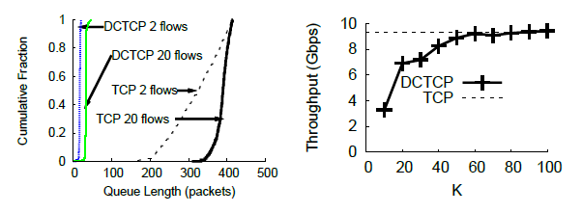
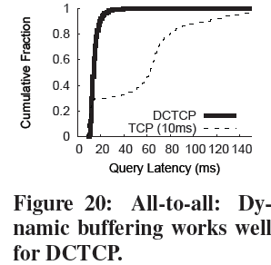
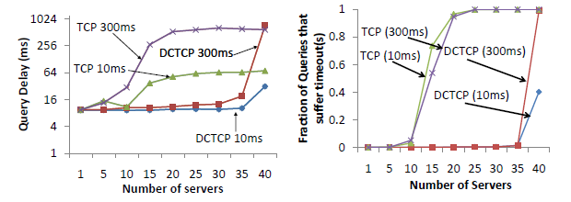
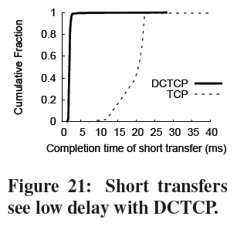
Data Center TCP (DCTCP)

Slide 11
Fat Tree Topology [Fares et al., 2008; Clos, 1953]
Multipath TCP: Congestion Control [NSDI, 2011] Map each flow to a path x => use many random paths for a flow => no collision
Multi-Path TCP
K=4
Aggregation Switches
K Pods with
K Switches
each
Racks of
servers

Slide 12
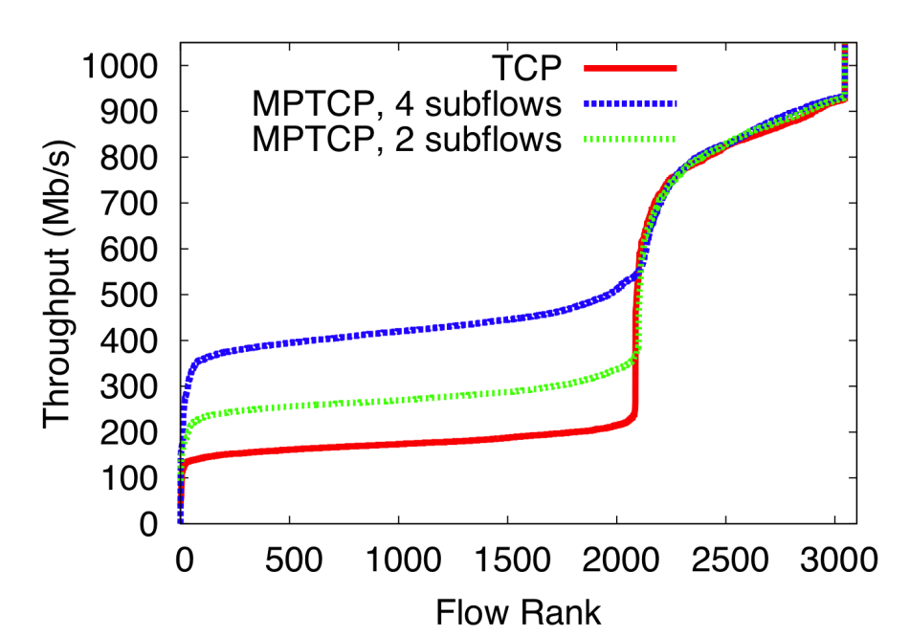
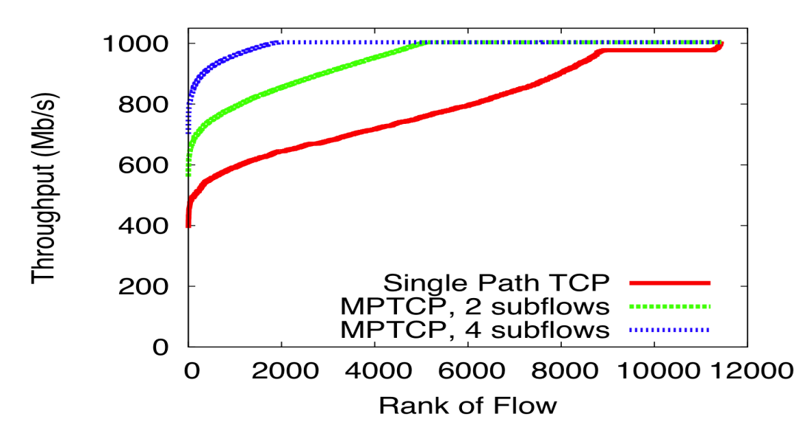
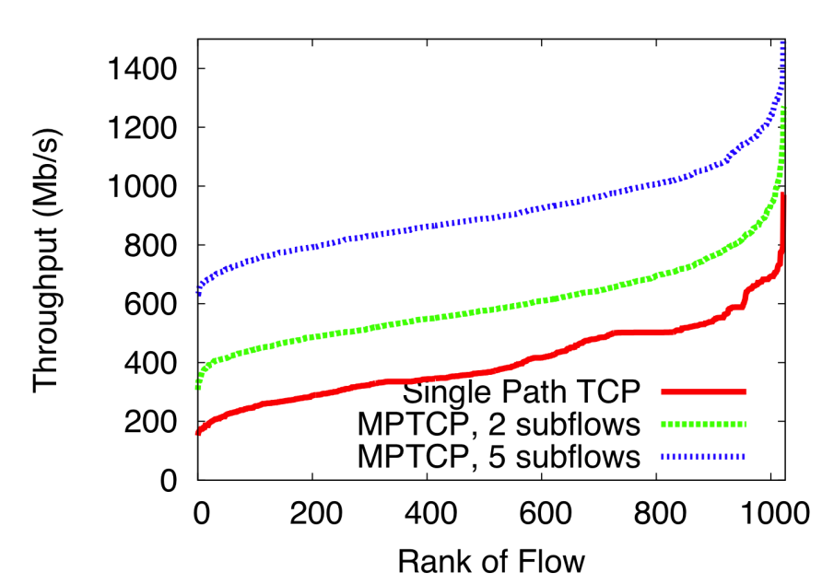
Multi-Path TCP

Slide 13
Virtualized Congestion Control from slide of the author
vCC
Translate between Congestion Control Algorithms in the Hypervisor
in order to
Achieve uniform congestion control in multitenant and enterprise datacenters
Programatically assign congestion control to fine-grained flow signatures
Simplify rollout of new congestion control algorithms.

Slide 14
Virtualized Congestion Control http://www.layer9.org/
Q: There are companies that do TCP header modifications. How is this work different from middleboxes?
A: We are proposing several techniques just other than TCP header modifications for congestion control translation.
Q: Could be done outside the server as a middlebox.
A: With middle boxes, you can only to TCP header modifications. You can do more with hypervisors
Q: Is there a cleaner way to do this?
A: Yes, there could be. But, it might not get too complicated if you do this way.

Slide 15
Virtualized Congestion Control http://www.layer9.org/
Q: Overhead against Open vSwitch (OVS)?
A: We don't use OVS, and we don't have any numbers for OVS yet.
Q: What are the limitations of header modifications. What can't you do?
A: Causing the guests to send if you go more aggressively than normally you would.
Q: What about UDP flows?
A: You might be able to. But requires different techniques.

